Slide 1


Final Project Defence on Data Technology Solutions BDM 1024
CREDIT CARD FRAUD ANALYSIS USING BIG DATA TOOLS
GROUP A
Koshish Aryal
Punam Bhattarai
Saaz Neupane
Bipin Pandey
Shweta Laljibhai Thummar
Manan Tushar Kapadia
Robert Thapa
Dipti Baral

Slide 2

DOMAIN
1
62% Perceive Increased Targeting
2
25% Experienced Fraud in 3 Years
3
35% Concerned About Identity Theft
4
26% Fear Online Card Theft

Slide 3

PROJECT GOALS
1
2
Detect fraudulent activities
Develop a robust fraud detection system

Slide 4








PROJECT FLOW AND IMPLEMENTATION
Database
Visualization
Our Team
Data
Cloud
Hadoop

Slide 5
PROBLEM STATEMENT
MERCHANT CATEGORY ANALYSIS
VOLUME AND VELOCITY CHALLENGES
BALANCING DETECTION COMPLEXITY
BUSINESS INSIGHTS
DATA-DRIVEN DECISIONS
OPTIMIZING MERCHANT CATEGORIES
AGED BASED BEHAVIOR INSIGHTS
ANAMOLY IDENTIFICATION

Slide 6
WHY OUR PRODUCT?
Our Product is a solution for efficient transaction analysis and data-driven decision-making.
Unparalleled Fraud Detection
Comprehensive Cardholder Insights
Data-Driven Business Strategies

Slide 7

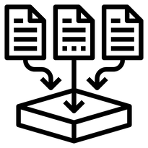

METHODOLOGY
DATA COLLECTION
SQL QUERIES
VISUALIZATION

Slide 8
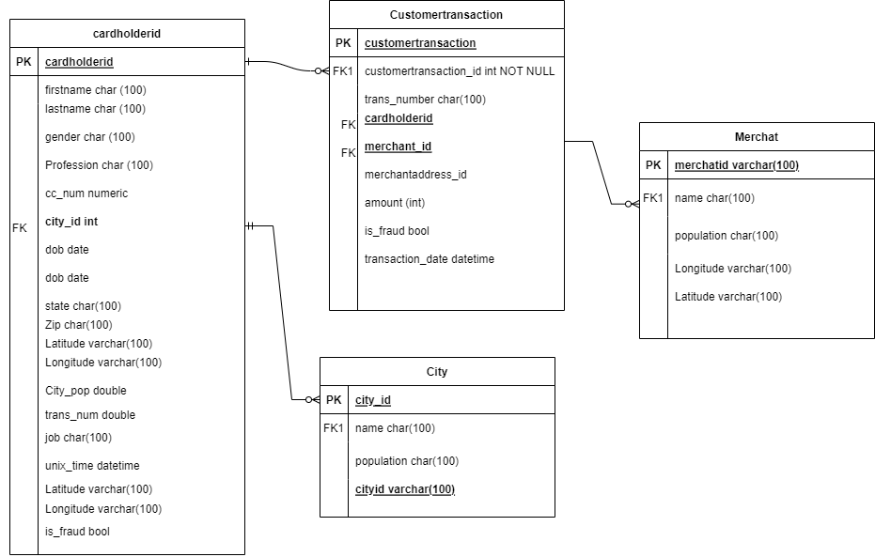
DATA MODEL DIAGRAM

Slide 9
INSIGHTS FROM SQL
1
Utilizing CTEs and window functions for cardholder-specific transaction analysis and fraud detection
2
Identifying High-Performing Categories Through Transaction Data Analysis
3
Identifying Unusual Transactions Using Standard Deviation

Slide 10
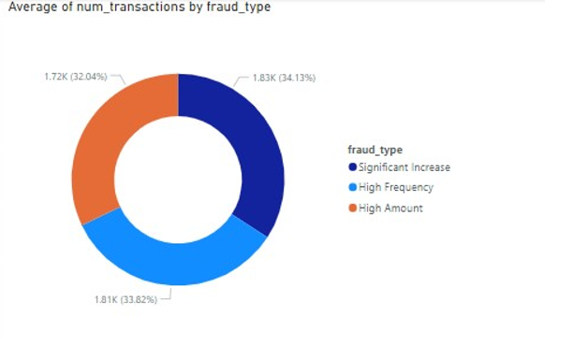
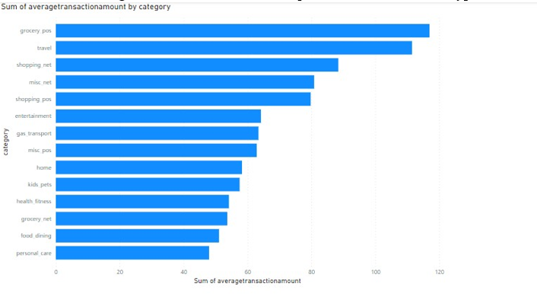
VISUALIZATION

Slide 11


BIG DATA TOOLS
HADOOP
SPARK

Slide 12
HADOOP
1
An open-source framework designed for distributed storage and processing of large datasets across clusters of computers
Running map reduce to get the frequency for the transactions based on category
2
3
Running map reduce to get the frequency to find the fraud and not fraud transaction

Slide 13
SPARK JOB
1
feature segmentations on population density, city population and recency
2
Categorizing customers into age groups, and calculation of the transaction amount
3
Identify merchants with total transaction amounts
4
Statistics calculation (Average, Standard deviation)

Slide 14
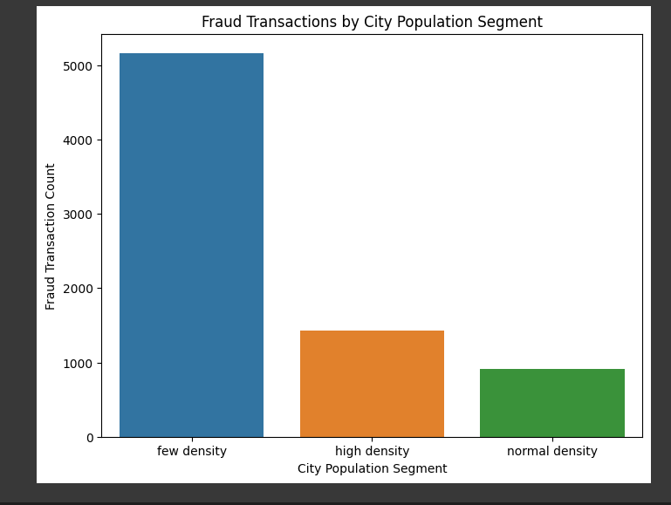
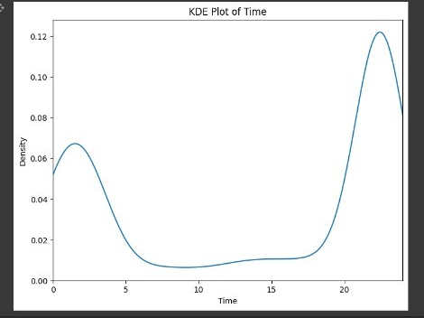
SPARK JOB FOR FEATURE ANALYSIS AND SEGMENTATION

Slide 15

CONCLUSION
Successfully designed and implemented database and performed analysis on credit card fraud dataset leveraging big data tools empowering the Banking Sector with Cutting-Edge technology, allowing to produce meaningful insights and making informed decision.

